Slide 1
Alert
The warning app
by
Julia
Markus
Peter

Slide 2
Task
build a model which is capable of correctly classifying tweets as either disaster tweets or false alerts

Slide 3
Strategy
reading data
clean keywords
transform text via NLP techniques
perform different ML approaches to find best differentiator
build app using a ML pipeline to predict alert situations

Slide 4
Workbench
Day 1:
Setup strategy (group)
data wrangling ( group)
NLP basics (group)
first prediction (group)
Beispiel: irgendwas von irgendwem präsentiert

Slide 5
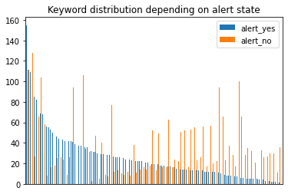
Workbench
Day 2:
find best pipe to predict real and false alerts (individual)
visualize keyword distribution depending on alert state (individual)
programming warning app for users (individual)
Beispiel: Keywords analytics by Peter

Slide 6
Workbench
Day 3:
Git (group)
different NLP and ML techniques ( group)
many different models tested
Markus mit großen Tabellen + einer Live Prediction

Slide 7
Workbench
Day 4
NER / POS approach tested
locations tested
Julia zeigt die Anwendungen rund um locations und NER/POS

Slide 8
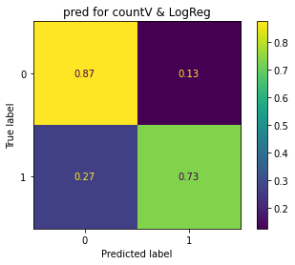
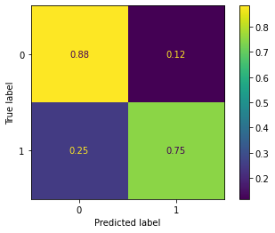
Progress
Day 1: Day 4:
Tfidf + LogReg Classifier
stacking approach:
LogReg, KNN, Naive Bayes
Score Confusion Matrix
0.7898193760262726
0.8260013131976363

Slide 9
Product
Warning App: https://x.thunkable.com/copy/57989626327f283cca1815d081083498

Slide 10
Backup

Slide 11
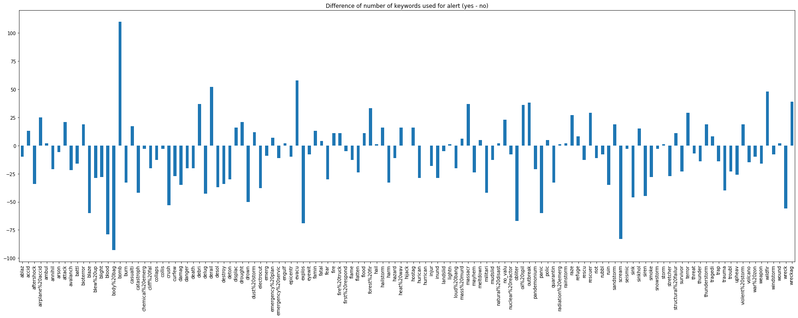
Useful graphs

Slide 12
Used techniques
Data wrangling
regex
replace by dict
POS / NER
ML
pipeline
Tfidf
CountVectorizer
XGBClassifier
stacking
App
thunkable

